Slide 1
Basic Concepts
Md. Moktadir Alam
Assistant Professor
Electrical and Electronic Engineering
Rangpur Engineering College, Rangpur.

Slide 2

Reference books
Fundamental of Electric circuit -Alexzender and sadiku
Introductory circuit analysis- Boylestad
Fundamentals of Electrical Engineering And Electronics- BL. Theraja
Electric circuits -Nilson And Riedel
Electric circuits- Schaums Otline- Mohammad Nahvi
Introduction to Electrical Engineering-Robert P. Ward

Slide 3
History (Frictional Electricity)
Magnetism
About 2000 years later
600 BC
Greek
William Gilbert
British
By Rubbing Amber
Other substances than amber could be electrified

Slide 4
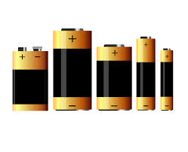
History (Current Electricity)
1733 Alessandro Volta
(Italy)
First wire transfer of electricity
Luigi Galvani
What are the phenomena that we got???

Slide 5
History : Practical Application
1844 Samuel Morse
Telegraph (1st commercial use)
1880 Thomas Edison
Electrical light and power industry

Slide 6
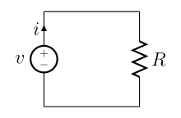
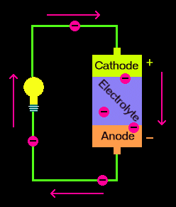
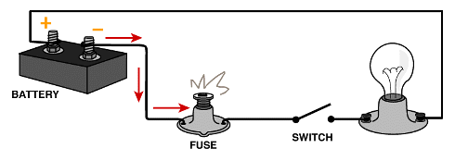
Electrical Circuit
A circuit is a closed loop that electrons can travel in. A source of electricity, such as a battery, provides electrical energy in the circuit.
A resistive circuit is a circuit containing only resistors and ideal current and voltage sources.
Define Close Circuit and Open Circuit.
According to the definition of circuit, can we call the above figures as a circuit? Give your opinion .
Define Ideal Current and Voltage Source

Slide 7
Circuit elements
There are five ideal basic circuit elements:
VOLTAGE SOURCES
CURRENT SOURCES
RESISTORS
INDUCTORS
CAPACITORS
There are two types of elements found in electric circuits :
Active element is one capable of generating electric energy.
Typical active elements include generators, batteries, and operational amplifiers
Passive elements are physical devices that cannot generate electric energy.
Resistors, inductors, and capacitors are examples of passive circuit elements.

Slide 8
Flow of Charge
Voltage: Energy per unit charge created by separation.
dw
V=
dq
V= the voltage in volts
w= the energy in joules
q= the charge in coulombs
Current: the rate of charge flow
dq
i=
dt
Whenever positive and negative charges are separated energy is expected
i= the current in amperes
t= the time in second
q= the charge in coulombs

Slide 9
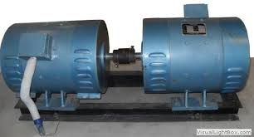
Electrical Source
An electrical source is a device that is capable of converting nonelectric energy to electric energy and vice versa.
A dynamo is a machine that converts mechanical energy to electric energy and vice versa.

Slide 10
Voltage Source
Voltage Source: A device which can produce a continuous force to move the electrons (or, continuous voltage) through the wire connected into the two terminals of the device is called a Voltage Source.
There are two types of the Voltage Source which are:
2. Alternating Voltage Source:
A device which produces a alternating direct voltage output is called a Alternating Voltage Source. For example: AC Generator , DC to AC converter etc.
A alternating voltage is the kind of voltage whose polarity is reversed periodically. Alternating Voltage causes the current to move in one direction for a period and then in another direction for another period.
1. Direct Voltage Source:
A device which produces a continuous direct voltage output is called a Direct Voltage Source. For example: Cells , Battery , DC Generator.
A direct voltage is the kind of voltage whose polarity remains the same. Direct Voltage causes the current to move only in one direction continuously.
+
+
᷉᷉
-
-

Slide 11
Current Source
Current Source:
A current source is a device which provides the regular flow or electrons or current on a circuit.
Direct Current Source:
The current source made of a Direct Voltage Source is called Direct Current Source.
Alternating Current Source:
The current source made of a Alternating Voltage Source is called Alternating Current Source.

Slide 12
Voltage Source
Ideal Voltage Source:
An Ideal Voltage source is a kind of Voltage source whose internal resistance is zero! Such that the supplied voltage does not changes even if the external load resistance is changes.
Ideal Current Source:
A current source which provides a constant current without any relation with the voltage supplied to the load is called Ideal Current Source.
Ideal sources are two types:
An independent source establishes a voltage or current in a circuit without relying on voltages or currents elsewhere in the circuit.
A dependent source establishes a voltage or current whose value depends on the value of a voltage or current elsewhere in the circuit.
There are four possible types of dependent sources, namely:
1. A voltage-controlled voltage source (VCVS).
2. A current-controlled voltage source (CCVS).
3. A voltage-controlled current source (VCCS).
4. A current-controlled current source (CCCS).

Slide 13
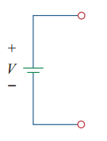
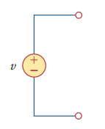
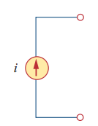


Symbols
independent voltage (DC) source
independent voltage (AC) sources
independent current source
Dependent voltage source
Dependent current source

Slide 14
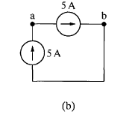
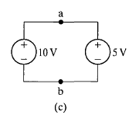
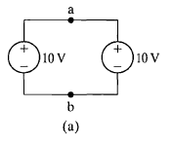
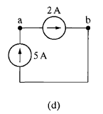
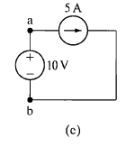
Problem Solving
Which connections are permissible and which violate the constraints imposed by the ideal sources ?
Notes:
Connection (a) is valid. Each source supplies voltage across the same pair of terminals, marked a,b. This requires that each source supply the same voltage with the same polarity, which they do.
Connection (b) is valid. Each source supplies current through the same pair of terminals, marked a,b. This requires that each source supply the same current in the same direction, which they do.
Connection (c) is not permissible. Each source supplies voltage across the same pair of terminals, marked a,b. This requires that each source supply the same voltage with the same polarity, which they do not.
Connection (d) is not permissible. Each sourcesupplies current through the same pair of terminals,
marked a,b. This requires that each source supply the same current in the same direction, which they do not.
Connection (e) is valid. The voltage source supplies voltage across the pair of terminals marked a,b. The current source supplies current through the same pair of terminals. Because an ideal voltage source supplies the same voltage regardless of the current, and an ideal current source supplies the same current regardless of the voltage, this is a permissible connection.

Slide 15
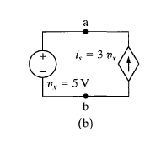
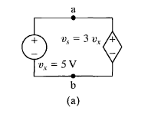
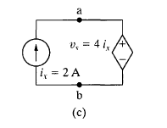
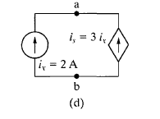
Problem solving (Home task)
Using the definitions of the ideal independent and dependent sources, state which interconnections in figures below are valid and which violate the constraints imposed by the ideal sources.

Slide 16
Bring your scientific calculator from next class
Thank you

